Slide 1
Street Dance
Polishing and improving our performance and dance logo design

Slide 2
Learning objectives
To understand the 'polishing' process of final rehearsal
To be able to respond to constructive criticism
To be able to perform in front of a peer audience
To design a logo.

Slide 3
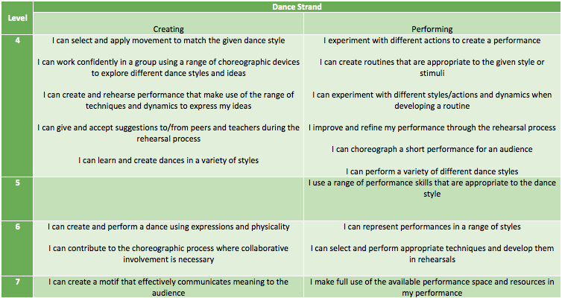
Success Criteria

Slide 4
Share your target grades…
This is what I think you are capable of getting at the end of the course if you…
Listen to feedback and practice
Behave and focus during lessons (remember the criteria I showed you)
Put as much detail as you can into log sheets
Be willing to give everything a go

Slide 5
Watch the video clips back from last week
What is good about them?
How can we improve for our performance next week?

Slide 6
Good:
You can do the basic movements of the dance
You can fill in your log sheet
You can turn up to lessons and behave appropriatley

Slide 7
Better:
You can perform the dance with some confidence and style
You can fill in a log sheet with detailed answers looking back at your targets, identifying your areas for development and areas of strength
You behave really well in lessons and are focused, always trying your hardest

Slide 8
Amazing
You can perform the dance with clear street dance style, it is big and confident with no mistakes
Your log sheets and work sheets show off how much you know about the subject, and that you know what you need to do to improve
Your behaviour is exceptional and you often help others who are struggling, taking a lead learner role

Slide 9
Finish learning the dance and the perform it in two halves
Remember: you need to be able to perform in front of an audience!

Slide 10
Next week is your assessment
You will perform in small groups of to an audience and be filmed
If you perform with confidence in a street dance style you have more chance of achieving higher marks.
You now have time to get into your groups and rehearse

Slide 11
Cool Down How have you progressed? What do you need to do in order to progress further?

